Slide 1


The Effect of Disclosing Genomic Risk of Coronary Heart Disease on LDL Cholesterol Levels: The Myocardial Infarction Genes (MI-GENES) Study
Embargoed Until 10:45 a.m. ET, Monday, Nov. 9, 2015
Iftikhar J. Kullo, M.D.
Late-breaking Clinical Trials
AHA Scientific Sessions, Orlando FL
November 9, 2015

Slide 2
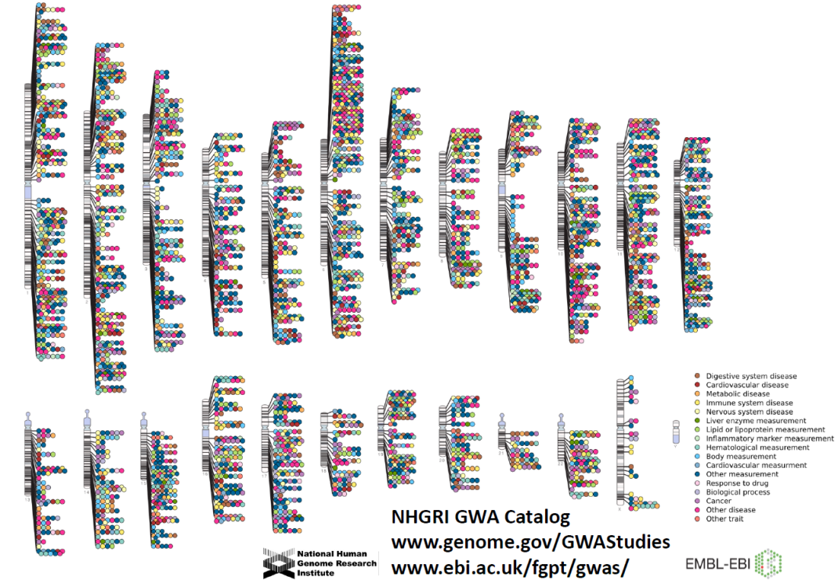
Background
Whether knowledge of genetic risk influences relevant clinical outcomes is unclear
We investigated whether disclosing a genetic risk score (GRS) for CHD derived from 28 genetic variants not related to BP/lipids would lower LDL-C

Slide 3
Hypotheses
Incorporating a GRS into conventional risk estimates ( ⁺GRS) would lead to lower LDL-C levels at 6 months than use of a conventional risk score (CRS)
Participants with a high ⁺GRS would have lower LDL-C than participants with average/low ⁺GRS and those randomized to receive CRS alone
⁺GRS = GRS x CRS

Slide 4
Enrollment
Mayo Clinic BioBank
n ~29,352
Screening criteria
  Age 45-65
  10-y CHD risk 5-20%
  Not on statins
  Olmsted County resident
Met screening criteria
n=2026
Screening genotyping
n=1000
Targeted recruitment
  110 high GRS (≥1.1)
  110 average/low GRS (<1.1)
Withdrew
n=9
Enrollment
n=216
207 underwent randomization
103 received conventional
10-yr risk for CHD
104 received conventional
10-y risk for CHD and
genetic risk information
At 12-week follow-up
  3 withdrew
  100 were assessed
At 12–week follow-up
  1 withdrew
  103 were assessed
Notes:
MCB →Screening criteria → 100 + 100 randomization, very low attrition (~4%).

Slide 5
Outcome measures
Primary outcome
LDL-C 6 mos after disclosure of CHD risk
Secondary outcomes
Dietary fat intake
Physical activity levels
Anxiety levels
Statin initiation

Slide 6
Incorporating GRS into risk estimates
10-year risk of CHD (CRS)
Wilson et al
Circulation 1998
8%
Genetic Risk Score (GRS, from 28 SNPs)
Ding et al
BMC Genomics 2012
1.3
Updated 10-year risk of CHD (⁺GRS)
8.0 x 1.3 = 10.4%

Slide 7
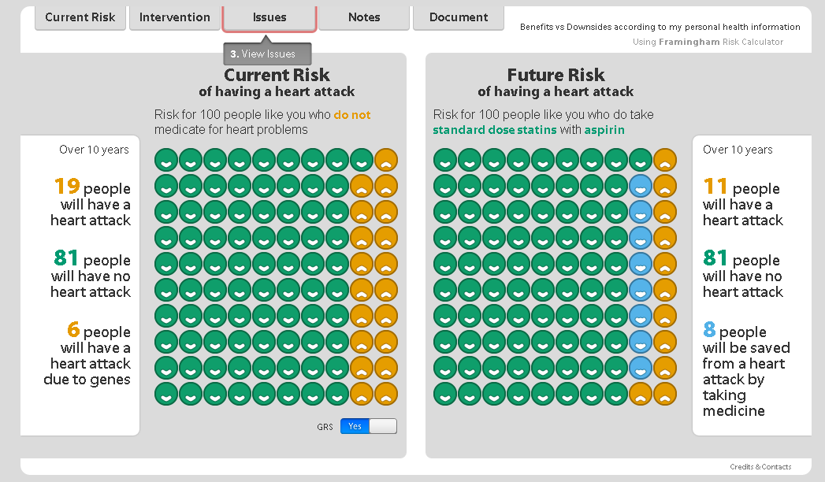
Genomic Decision Aid

Slide 8
Disclosure of risk
(Genetic Counselor)
Shared decision making
(Physician)

Slide 9


Study design
Blood
draw
CHD Risk
Disclosure
Blood
draw
Blood
draw
Genotyping
of 28 CHD
susceptibility
SNPs
LDL-C at 3 months
Diet & activity
Anxiety levels
Statin initiation
1° outcome
  LDL-C at
  6 months
2° outcomes
  Diet & activity
  Anxiety levels
  Statin initiation
Meet with
genetic
counselor
GRS
Meet with
clinician
Visit 1
Visit 2
Visit 3
Visit 4
Completed
n=216
Completed
n=207
Completed
n=203
Completed
n=202

Slide 10
Participant characteristics
 | CRS n=100 | ⁺GRS n=103
Age, years | 59.4±5.3 | 59.4±4.9
Male sex, no. (%) | 49 (49.0%) | 48 (46.6%)
Ever smoker, no. (%) | 41 (41.0%) | 32 (31.1%)
Family history of CHD, no. (%) | 30 (30.0%) | 25 (24.3%)
Body mass index (kg/m²) | 30.5±7.0 | 30.2±6.1
Total cholesterol (mg/dL) | 200.8±30.2 | 203.3±27.6
LDL-C (mg/dL) | 118.8±23.9 | 119.8±26.4
College education or higher, no. (%) | 67 (67.0%) | 58 (56.3%)
GRS | 1.11±0.30 | 1.14±0.29
CRS | 8.48±3.76 | 8.56±4.47

Slide 11
6-month LDL-C levels
P=0.04
P=0.02
LDL-C (mg/dL)
LDL-C (mg/dL)
CRS
⁺GRS
CRS
⁺L-GRS
⁺H-GRS

Slide 12
LDL-C levels over the study period
P=0.03
P=0.007
120
  CRS
  ⁺GRS
120
  CRS
  ⁺L-GRS
  ⁺H-GRS
115
115
110
110
105
105
LDL-C (mg/dL)
100
100
95
*
95
90
90
*
Between group difference in the slope of LDL-C after randomization was assessed in a mixed effects model

Slide 13
Fat intake and physical activity
Anxiety levels
Fat intake index
Physical activity score
Anxiety score
CRS
⁺GRS
CRS
⁺GRS
CRS
⁺GRS
Thompson FE, J Am Diet Assoc 2007;107:760-767.
Mayer CJ, Prev Chronic Dis 2008;5:A24.
Spielberger C, Consulting Psychologists Press 1983.

Slide 14
LDL-C decrease and statin initiation
LDL-C (mg/dL)
  CRS
  ⁺GRS
Using statin (%)

Slide 15
Conclusions
Disclosure of a CHD risk estimate that included genetic information led to lower LDL-C levels at 6 months than disclosure of a conventional risk estimate
The lowering of LDL-C was greatest in individuals with a high GRS for CHD
Disclosure of a GRS was associated with higher frequency of statin initiation but there were no significant changes in dietary fat intake, physical activity levels, or anxiety

Slide 16
Strengths
Integration of genetic risk information for a common disease in the EHR with linkage to a genomic decision aid
Shared decision making in the context of GRS disclosure
Incorporating a GRS into disease risk estimates to alter a relevant health outcome (LDL-C)

Slide 17
Limitations
Prospective validation of GRS
Genetic risk score category |  | Hazard ratio (95% CI) | P
Low risk |  | Reference
Intermediate risk |  | 1.34 (1.22-1.47) | <0.0001
High risk |  | 1.72 (1.55-1.92) | <0.0001
0.80
1.0
1.25
2.0
Mega et al, Lancet 2015; 385: 2264-71
Hazard ratio (95% CI)
Additional studies needed for individuals of non-European ancestry

Slide 18
Clinical implications
Genetic risk information for CHD can be effectively incorporated in the EHR and used at point of care to guide therapy
Disclosure of a GRS led to lower LDL-C levels, more so in those at higher genetic risk
Our study exemplifies Precision Medicine and motivates further investigation of the clinical utility of genetic risk assessment for prevention of CHD
Notes:
Significant implications for public health since CHD is leading cause of death;

Slide 19


Acknowledgements
MIGENES Team
Iftikhar J. Kullo, MD
Hayan Jouni, MD
Erin E. Austin, PhD
Teresa M. Kruisselbrink, GCS
Sherry-Ann Brown, MD PhD
Iyad N. Isseh, MBBS
Raad A. Haddad, MBBS
Tariq Marroush, MD
Shameer Khader, PhD
Janet E. Olson, PhD
Maya S. Safarova, MD PhD
Daniel J. Schaid, PhD
Ulrich Broeckel, MD
Robert C. Green, MD MPH
Victor M. Montori, MD
Kent R. Bailey, PhD
NHGRI HG-06379

